Slide 1
CHAPTER 4
Software Quality Assurance

Slide 2
Quality
Quality is a complex and multifaceted concept that can be described from five different points of view:
Transcendental view: something that immediately recognizes, but cannot explicitly define.
User view: If a product meets an end user’s specific goals, it exhibits quality.
Manufacturer’s view: Product conforms to the original specification.
Product view: Quality can be tied to inherent characteristics (e.g., functions and features) of a product.
Value-based view: How much a customer is willing to pay for a product?

Slide 3
Quality
quality encompasses all of these views and more.
user satisfaction = compliant product + good quality + delivery within budget and schedule

Slide 4
Software Quality
“An effective software process applied in a manner that creates a useful product that provides measurable value for those who produce it and those who use it “.

Slide 6
The definition serves to emphasize three important points:
Effective software process: establishes the infrastructure that supports any effort at building a high-quality software product.
Useful product: delivers the content, functions, and features that the end user desires in a reliable, error-free way.
Measurable values: For,
producer:
High-quality software requires less maintenance effort, fewer bug fixes, and reduced customer support.
end user:
(1) greater software product revenue
(2) better profitability when an application supports a business process

Slide 7
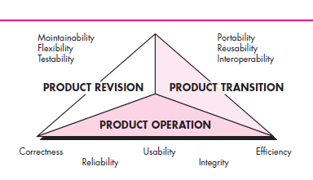
McCall’s software quality factors

Slide 8
Correctness: The extent to which a program satisfies its specification and fulfills the customer’s mission objectives.
Reliability. The extent to which a program can be expected to perform its intended function with required precision
Efficiency. The amount of computing resources and code required by a program to perform its function.
Integrity. Extent to which access to software or data by unauthorized persons can be controlled.

Slide 9
Usability: Effort required to learn, operate, prepare input for, and interpret output of a program.
Maintainability: Effort required to locate and fix an error in a program.
Flexibility :Effort required to modify an operational program. Testability: Effort required to test a program to ensure that it performs its intended function.
Portability: Effort required to transfer the program from one hardware and/or software system environment to another.

Slide 10
Reusability: Extent to which a program [or parts of a program] can be reused in other applications.
Interoperability: Effort required to couple one system to another.

Slide 11
Quality Factors
The ISO 9126 standard was developed in an attempt to identify the key quality attributes for computer software.
The standard identifies six key quality attributes:

Slide 12
ISO 9126
Functionality
Reliability
Usability
Efficiency.
Maintainability.
Portability.

Slide 13
Software Quality Dilemma
If you produce a software system that has terrible quality, you lose because no one will want to buy it.
If on the other hand you spend infinite time, extremely large effort, and huge sum of money to build the absolutely perfect piece of software, then it’s going to take so long to complete and it will be so expensive to produce that you’ll be out of business anyway.
Either you missed the market window, or you simply exhausted all your resources.

Slide 15
Software Quality Dilemma
So people in industry try to get to that magical middle ground where the product is good enough not to be rejected right away, such as during evaluation, but also not the object of so much perfectionism and so much work that it would take too long or cost too much to complete.

Slide 16
Software quality attributes
Integrity : security , how system handles unwanted threats .
Flexibility : Easy to change, how flexible to change
Interoperability : how effectively communicating one system to another system.

Slide 17
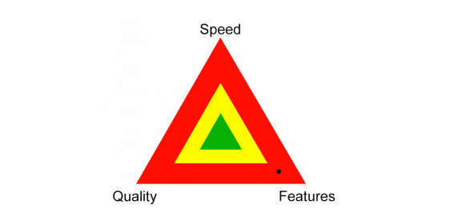

Slide 18
Good Enough Software
Good enough software delivers high-quality functions and features that users desire, but at the same time it delivers other more obscure or specialized functions and features that contain known bugs.
The software vendor hopes that the vast majority of end users will overlook the bugs because they are so happy with other application functionality.

Slide 19
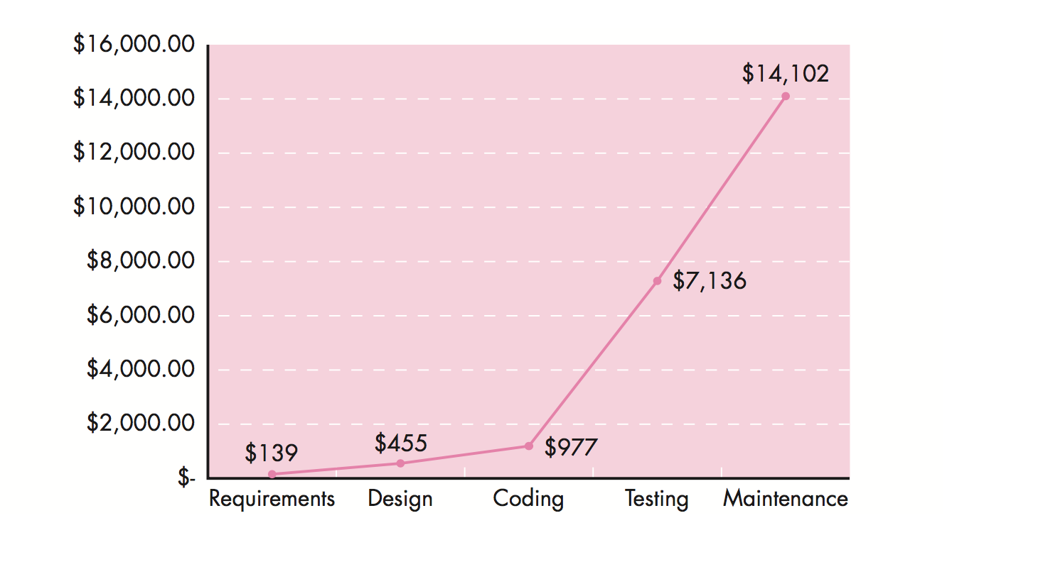
Cost of Quality

Slide 20
Cost of Quality
The industry average cost to correct a defect during code generation is approxi- mately $977 per error.
The industry average cost to correct the same error if it is discovered during system testing is $7,136 per error

Slide 21
Cost of Quality
The cost of quality can be divided into costs associated with prevention, appraisal, and failure.
Prevention costs include:
(1) the cost of management activities required to plan and coordinate all quality control and quality assurance activities,
(2) the cost of added technical activities to develop complete requirements and design models,
(3) test planning costs, and
(4) the cost of all training associated with these activities.

Slide 22
Cost of Quality
Appraisal costs: include activities to gain insight into product condition the “first time through” each process. E.g
Cost of conducting technical reviews
Cost of data collection and metrics evaluation
Cost of testing and debugging
Failure: costs are those that would disappear if no errors appeared before or after shipping a product to customers
Failure costs may be subdivided into internal failure costs and external failure costs
Internal failure costs are incurred when you detect an error in a product prior to shipment

Slide 23
Cost of Quality
External failure costs are associated with defects found after the product has been shipped to the customer.

Slide 24
Quality Control
Quality control encompasses a set of software engineering actions that help to ensure that each work product meets its quality goals.
Models are reviewed to ensure that they are complete and consistent.
Code may be inspected in order to uncover and correct errors before testing commences.

Slide 25
A series of testing steps is applied to uncover errors in processing logic, data manipulation, and interface communication.
A combination of measurement and feedback allows a software team to tune the process when any of these work products fail to meet quality goal

Slide 26
Formal Technical Review
A formal technical review (FTR) is a software quality control activity performed by software engineers (and others).
The objectives of an FTR are:
(1) to uncover errors in function, logic, or implementation for any representation of the software;
(2) to verify that the software under review meets its requirements;
(3) to ensure that the software has been represented according to predefined standards;

Slide 27
(4) to achieve software that is developed in a uniform manner; and
(5) to make projects more manageable.
In addition, the FTR serves as a training ground, enabling junior engineers to observe different approaches to software analysis, design, and implementation.
The FTR also serves to promote backup and continuity because a number of people become familiar with parts of the software that they may not have otherwise seen

Slide 28
Formal Technical Review
The FTR is actually a class of reviews that includes walkthroughs and inspections.
Each FTR is conducted as a meeting and will be successful only if it is properly planned, controlled, and attended

Slide 29
The Review Meeting
Between three and five people (typically) should be involved in the review.
• Advance preparation should occur but should require no more than two hours of work for each person. • The duration of the review meeting should be less than two hours.

Slide 30
Formal Technical Review
The Players of Review Meeting
Producer—the individual who has developed the work product
Informs the project leader that the work product is complete and that a review is required.
Review leader—evaluates the product for readiness, generates copies of product materials, and distributes them to two or three reviewers for advance preparation.
Reviewer(s)—expected to spend between one and two hours reviewing the product, making notes, and otherwise becoming familiar with the work.
Recorder— a reviewer who records (in writing) all important issues raised during the review.

Slide 31
Formal Technical Review
Review Summary Report
What was reviewed?
Who reviewed it?
What were the findings and conclusions?

Slide 32
FTR Guidelines
Review the product, not the producer
Set an agenda and maintain it.
Limit debate and rebuttal
Enunciate problem areas, but don’t attempt to solve every problem noted

Slide 33
FTR Guidelines
5.Take written notes.
6.Limit the number of participants and insist upon advance preparation
7.Develop a checklist for each product that is likely to be reviewed
8.Allocate resources and schedule time for FTRs
9.Conduct meaningful training for all reviewers
10.Review your early reviews

Slide 34
Elements of software Quality Assurance
Software quality assurance encompasses a broad range of concerns and activities that focus on the management of software quality .
Standards. The IEEE, ISO, and other standards organizations have produced a broad array of software engineering standards and related documents
Reviews and audits. Technical reviews are a quality control activity performed by software engineers for software engineers. Their intent is to uncover errors
Testing. Software testing is a quality control function that has one primary goal to find errors.

Slide 35
Elements of Software Quality Assurance
Error/defect collection and analysis: SQA collects and analyzes error and defect data to better understand how errors are introduced and what software engineering activities are best suited to eliminating them
Change Management: If it is not properly managed, change can lead to con-fusion, and confusion almost always leads to poor quality.
Education: The SQA organization takes the lead in software process improvement and is a key proponent and sponsor of educational programs.
Vendor management. The job of the SQA organization is to ensure that high-quality software results by suggesting specific quality practices that the vendor should follow (when possible), and incorporating quality mandates as part of any contract with an external vendor.

Slide 36
Elements of Software Quality Assurance
Security Management: SQA must ensures that appropriate process and technology are used to achieve software security.
Safety: SQA may be responsible for assessing the impact of software failure and for initiating those steps required to reduce risk.
Risk Management: SQA organization must ensures that risk management activities are properly conducted and that risk-related contingency plans have been established.

Slide 37
SQA task, Goals and Metric
Prepares an SQA plan for a project :
Participates in the development of the project’s software process description.

Slide 38
SQA task, Goals and Metric
Reviews software engineering activities to verify compliance with the defined software process.
Audits designated software work products to verify compliance with those defined as part of the software process

Slide 39
SQA task Goals and Matric
Ensures that deviations in software work and work products are documented and handled according to a documented procedure. :
Records any noncompliance and reports to senior management.

Slide 40
Statistical Software quality assurance
Statistical quality assurance reflects a growing trend throughout industry to become more quantitative about quality
For software, statistical quality assurance implies the following steps:

Slide 41
Statistical Software quality assurance
Information about software errors and defects is collected and categorized.
An attempt is made to trace each error and defect to its underlying cause (e.g., nonconformance to specifications, design error, violation of standards, poor communication with the customer).
Using the Pareto principle (80 percent of the defects can be traced to 20 percent of all possible causes), isolate the 20 percent (the vital few).
Once the vital few causes have been identified, move to correct the problems that have caused the errors and defects.

Slide 42
Six Sigma for Software Engineering
Six Sigma is the most widely used strategy for statistical quality assurance in industry today
Originally popularized by Motorola in the 1980s, the Six Sigma strategy “is a rigorous and disciplined methodology that uses data and statistical analysis.

Slide 43
Six Sigma for Software Engineering
The Six Sigma method-ology defines three core steps:
Define customer requirements and deliverables and project goals via well- defined methods of customer communication.
Measure the existing process and its output to determine current quality performance
Analyze defect metrics and determine the vital few causes.

Slide 44
Software Reliability
Software reliability is defined in statistical terms as “the probability of failure-free operation of a computer program in a specified environment for a specified time”
To illustrate, program X is estimated to have a reliability of 0.999 over eight elapsed processing hours.
In other words, if program X were to be executed 1000 times and require a total of eight hours of elapsed processing time (execution time), it is likely to operate correctly (without failure) 999 times.

Slide 45
Measure of Reliability and Availability
If we consider a computer-based system, a simple measure of reliability is mean- time-between-failure (MTBF):
MTBF = MTTF + MTTR where the acronyms MTTF and MTTR are mean-time-to-failure and mean-time-to Repair.

Slide 46
Measure of Reliability and Availability
In addition to a reliability measure, you should also develop a measure of availability.
Software availability is the probability that a program is operating according to requirements at a given point in time and is defined as
Availability= (MTTF )/(MTTF+ MTTR) *100
The MTBF reliability measure is equally sensitive to MTTF and MTTR.
The avail- ability measure is somewhat more sensitive to MTTR, an indirect measure of the maintainability of software.

Slide 47
Software Safety
Software safety is a software quality assurance activity that focuses on the identification and assessment of potential hazards that may affect software negatively and cause an entire system to fail.
If hazards can be identified early in the software process, software design features can be specified that will either eliminate or control potential hazards.

Slide 48
THE SQA PLAN
The SQA Plan provides a road map for establishing software quality assurance.
Developed by the SQA group (or by the software team if an SQA group does not exist), the plan serves as a template for SQA activities that are established for each software project.

Slide 49
THE SQA PLAN
A standard for SQA plans has been published by the IEEE . The standard recommends a structure that identifies
1. The purpose and scope of the plan
2. Description of all software engineering work products (e.g., models, documents, source code)
4. All applicable standards and practices that are applied during the software process.
5. SQA actions and tasks (including reviews and audits) and their placement throughout the software process)

Slide 50
THE SQA PLAN
6. The tools and methods that support SQA actions and tasks
7. Software configuration management procedures
8. Methods for assembling, safeguarding, and maintaining all SQA-related records
9. Organizational roles and responsibilities relative to product quality.

Slide 51
International Standard Organization(ISO)
The ISO 9000 standards specifies the guidelines for maintaining a quality system.
ISO 9000 is a series of three standards: ISO 9001, ISO 9002, and ISO 9003
The ISO 9000 series of standards is based on the premise that if a proper process is followed for production, the good quality products are bound to automatically follow.

Slide 52
ISO
The types of software industries to which the different ISO standards apply are as follows:
ISO 9001: The standard applies to the organization engaged in the design, development, production, and serving of the goods.
This is the standard that is applicable to most software development organization.

Slide 53
ISO
ISO 9002 : This standard applies to the organizations that do not design the product but are only involved in the production.
Example: steel or car manufacturing industries who buy the product plant design and involve in only manufacturing

Slide 54
ISO
ISO 9003: Applied for those organizations which involved only in installation and testing of the products

Slide 55
Why to get ISO certification
Confidence of customers in an organization is enhanced
ISO 9000 requires a well documented software production process which contributes to higher quality and repeatable developed software .
Makes the development process focused, efficient and cost effective
Points out the weak points of an organizations and recommends remedial actions.
Sets the basic framework for development of an optimal process.

Slide 56
How to get ISO Certifications
An organizations intending to obtain the ISO certifications applies to an ISO 9000 registrar for registration.
The ISO 9000 registration process consists of the following stages :
Application Stage:
Pre-assessment
Document review and adequacy audit
Compliance Audit
Registration
Continued Surveillance

